Slide 1




Unveiling insights with Welch´s t-test
Exercise of Statistical Inference for Data Science (Module2)
By Avisek Regmi, Gaëlle Marti, Sara Manafzadeh, and Simon Rime
1st September 2023

Slide 2
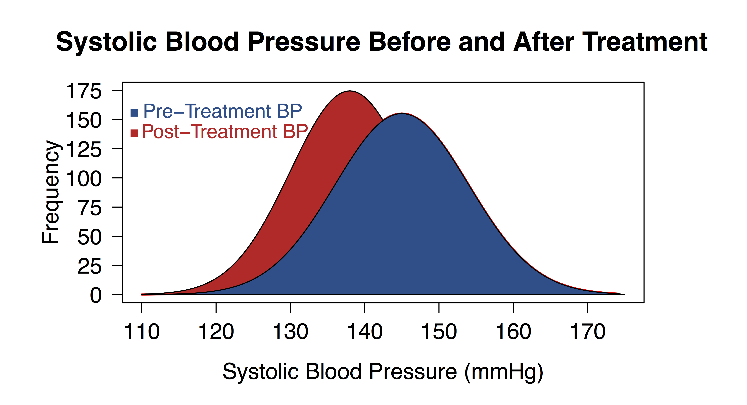

Unveiling insights with Welch´s t-test
A powerful statistical tool for uncovering differences
Designed for comparing means of 2 groups with unequal variances (standard deviation)
Why Welch´s t-test?
Traditional t-test assumes equal variances; however, Welch handles unequal ones.
Well-suited for real-World scenarios with varying data distributions.
Welch, B. L. (1947)
Benefits of Welch´s t-test:
Accurate results even with unequal variances and sample sizes.
Empowers data-driven decision-making.
Widely used in research, business, and beyond.

Slide 3

Scenario and Hypotheses
A
Scenario:
2 groups of students in Literature class
Group A was taught using Method A
Group B was taught using Method B
Each group consists of 30 students
Their mean scores are as follows (grades from 2 to 6)
B
Hypotheses:
H0: There is no significant difference in the mean literature test scores between students taught with Method A and Method B.
Ha: There is a significant difference in the mean literature test scores between students taught with Method A and Method B.

Slide 4
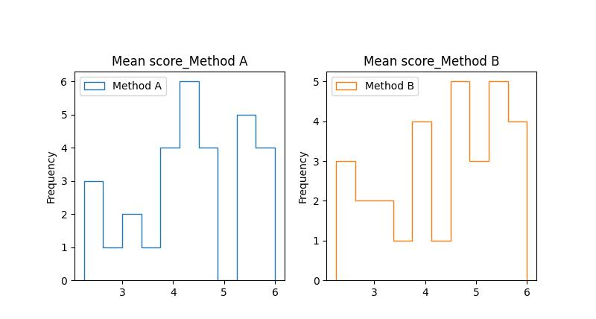
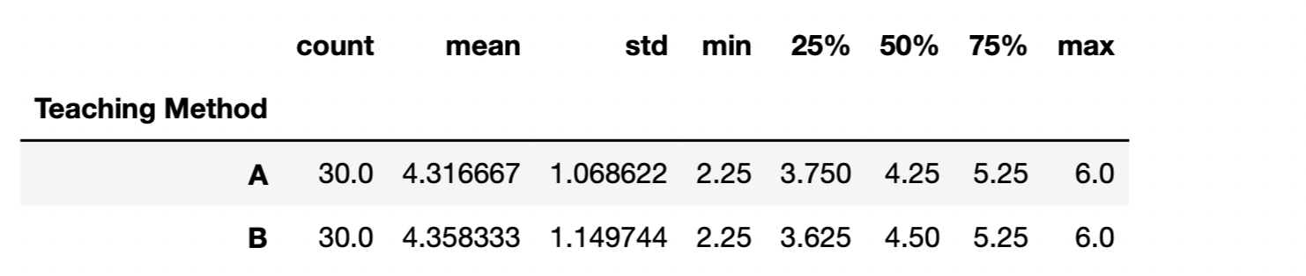
Results
Descriptive statistics
Data Distribution
Checking normality distribution
 | Mean | Standard Deviation
Method A | 4.31 | 1.06
Method B | 4.35 | 1.14
D’Agostino-Pearson test (normality test)
P-value A: 0.4
P-value B: 0.26
both follow a normal distribution

Slide 5

Welch's t-test results & conclusion
Our result Fails to reject the null hypothesis (H0): There is no significant difference in mean scores. This outcome provides valuable insights into the efficacy of teaching methods A and B and informs educators on the potential benefits and drawbacks of each approach.

